Slide 1
Multi-objective Optimization

Slide 2
Minimum Crowding Path Algorithm
A novel hierarchical algorithm is developed
Optimize for both crowded duration and travel time
Single Objective Formulation: Minimize travel time
Multi-objective Formulation:
Minimize crowded duration and use K-shortest paths based algorithm to increase crowded duration in every iteration and reach the path corresponding to the minimum travel time
Implemented on a sample network with 24 nodes and 76 links
Non-Dominated Pareto optimal solution set obtained in the case of Multi-objective optimization

Slide 3
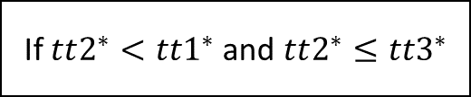
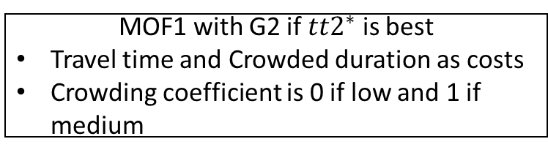
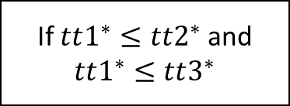
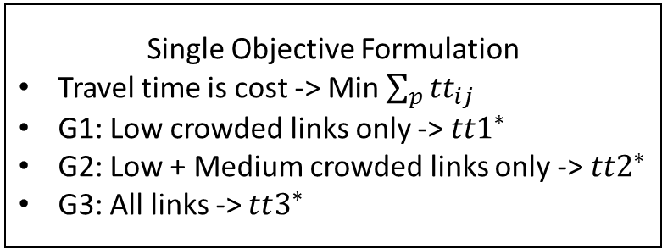
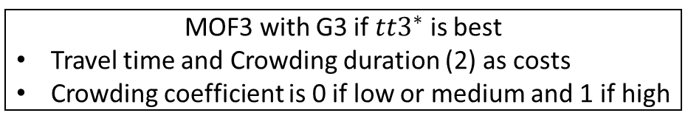
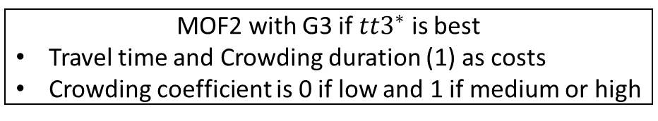
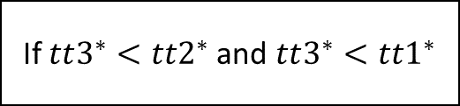
Single Objective Formulation
Travel time is cost -> Min $\sum_{p}{{tt}_{ij}}$
G1: Low crowded links only -> $tt1^{∗}$
G2: Low + Medium crowded links only -> $tt2^{∗}$
G3: All links -> $tt3^{∗}$
If $tt2^{∗}<tt1^{∗}$and $tt2^{∗}≤tt3^{∗}$
Minimum Crowding Path Algorithm
MOF1 with G2 if $tt2^{∗}$ is best
Travel time and Crowded duration as costs
Crowding coefficient is 0 if low and 1 if medium
If $tt1^{∗}≤tt2^{∗}$and $tt1^{∗}≤tt3^{∗}$
If $tt3^{∗}<tt2^{∗}$and $tt3^{∗}<tt1^{∗}$
KSP based algorithm for MOF1
Optimal path reached
Non Dominated Set 1
MOF2 with G3 if $tt3^{∗}$ is best
Travel time and Crowding duration (1) as costs
Crowding coefficient is 0 if low and 1 if medium or high
MOF3 with G3 if $tt3^{∗}$ is best
Travel time and Crowding duration (2) as costs
Crowding coefficient is 0 if low or medium and 1 if high
KSP based algorithm for MOF2
Non Dominated Set 2
Candidate Set
Combine ND2, ND3
KSP based algorithm for MOF3 Non Dominated Set 3
Non Dominated Set wrt $tt$, crowding duration 1, crowding duration 2

Slide 4
S.No | Path (Sequence of Nodes) | Travel Time | Medium Crowded Duration | High Crowded Duration
0 | 1, 3, 12, 11, 10, 16 | 34.85 | 19.23 | 15.61
1 | 1, 3, 12, 11, 10, 17, 16 | 48.08 | 19.23 | 14.75
2 | 1, 2, 6, 8, 7, 18, 16 | 59.9 | 43.73 | 10.8
Path | Travel Time | Medium Crowded Duration | High Crowded Duration
Ideal | 34.85 | 11.91 | 6.00
S.No | Path (Sequence of Nodes) | Travel Time | Crowded Duration 1 | Crowded Duration 2
0 | 1, 3, 12, 11, 10, 16 | 34.85 | 15.61 | 34.84
1 | 1, 3, 12, 11, 10, 17, 16 | 48.08 | 14.75 | 33.98
2 | 1, 2, 6, 8, 7, 18, 16 | 59.9 | 10.8 | 54.53
Path | Travel Time | Crowded Duration 1 | Crowded Duration 2
Ideal | 34.85 | 6.00 | 17.91

Slide 5
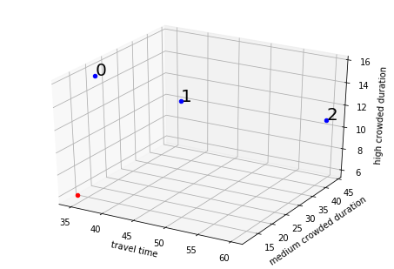
Figure: Optimal paths ideal paths for sample network with origin as node ‘1’ and destination as node ‘16’

Slide 6
S.No | Path (Sequence of Nodes) | Travel Time | Medium Crowded Duration | High Crowded Duration
0 | 5, 4, 11, 14, 15, 19, 20 | 42.48 | 8.33 | 15.74
1 | 5, 6, 8, 16, 18, 20 | 41.23 | 14.47 | 26.76
2 | 5, 6, 8, 7, 18, 20 | 46.94 | 27.18 | 14.39
Path | Travel Time | Medium Crowded Duration | High Crowded Duration
Ideal | 36.44 | 7.66 | 3.95
S.No | Path (Sequence of Nodes) | Travel Time | Crowded Duration 1 | Crowded Duration 2
0 | 5, 4, 11, 14, 15, 19, 20 | 42.48 | 15.74 | 2.07
1 | 5, 6, 8, 16, 18, 20 | 41.23 | 26.76 | 41.23
2 | 5, 6, 8, 7, 18, 20 | 46.94 | 14.39 | 41.57
Path | Travel Time | Crowded Duration 1 | Crowded Duration 2
Ideal | 36.44 | 3.95 | 11.61

Slide 7
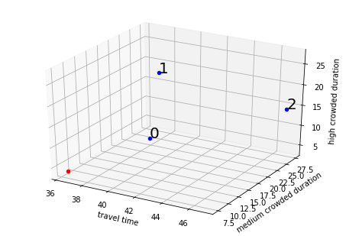
Figure: Optimal paths ideal paths for sample network with origin as node ‘5’ and destination as node ‘20’

Slide 8
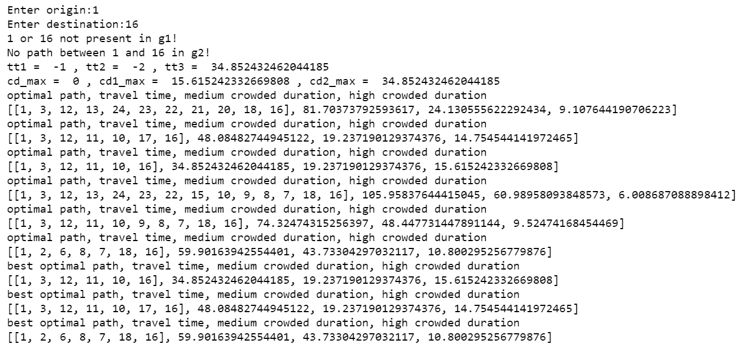
Figure: Output for the sample network with origin as node ‘1’ and destination as node ‘16’

Slide 9
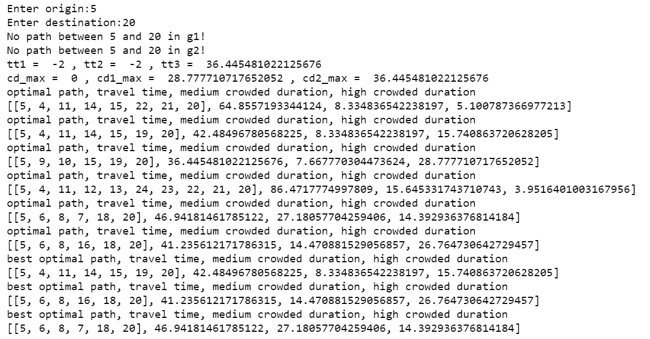
Figure: Output for the sample network with origin as node ‘5’ and destination as node ‘20’

